Slide 1
Fake Product review Detection and Analysis Under Guidance of Mrs.K.Raja Sree Department of CSE
Team Members
K.Vijaya Lakshmi(N150821)
D.Priyanka(N150554)
M.B.S.M.Deepika(N151129)

Slide 2
Agenda
Introduction
Overview
Requirements
Implementation Architecture
Steps
TextBlob
Features
Fake review Detection
Final Output

Slide 3
Introduction
Now a days online buyers are so much aware and sensitive to product reviews.usually before buying any product from e-commerce they use to read product review and ratings.That’s why it is too much necessary e-commerce website owners to keep watch on product reviews and description.Users use to blame e-commerce websites if they sell product with bad reviews rather than product manufacturers which may ruin the reputation of e-commerce website and brand. Sometimes competitors use fake reviews to improve their sells.For such e-commerce website owners ,we have created one product system which is fake product review detection and analysis.

Slide 4
Overview
This system helps the user to find out correct review of the product and remove it from the portal if it is fake. We need to provide e-commerce owner login id for accessing web portal with one secured key.Through that id,owner can over look on various items and can give survey about those items.
To find out the audit is certified,framework will track IP address of the client if the framework watch counterfeit survey send by a similar IP address numerous multiple times, it will illuminate the administrator to explore that survey from the framework.

Slide 5
Requirements
Hardware Requirements
Processor : i3
Memory : 4GB RAM
System : 64bit OS
Software Requirements
Operating system : Windows 10
Programming Language : python 3.5.2
Libraries : Numpy, scikit-learn, NLTK.
Platform Used : Google Colab.

Slide 6
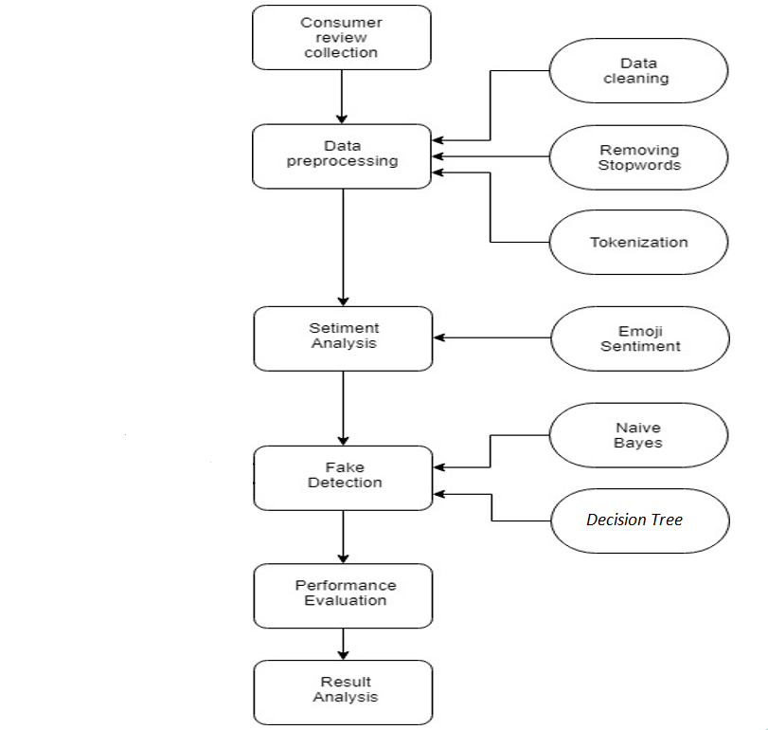
Implementation Architecture

Slide 7
Steps to identify products fake reviews & remove from portal
1.Data Preprocessing : Preprocess the data by removal of irrelevent and noisy as well as unrealiable data from the review dataset.
2.Tokenization: We usually break the data into words,phrases and meaningful elements in order to explore the words present in a sentence.
Tokenization is divided into 2 parts : 1) Sentance Tokenization 2) Word Tokenization

Slide 8
Cont..
3.Removal of Punctuation marks :Punctuation marks are removed along with the additional white spaces and commas
4.Stop-word Elimination : Affixes are remove from Stem.
for ex : stem looking - look it will take.
5.Training the classfier: Train our system for identification of fake product reviews by using predictive based test data analysis.
For ex : “ This product is not looking good”, i’m not satisfied flipcart.

Slide 9
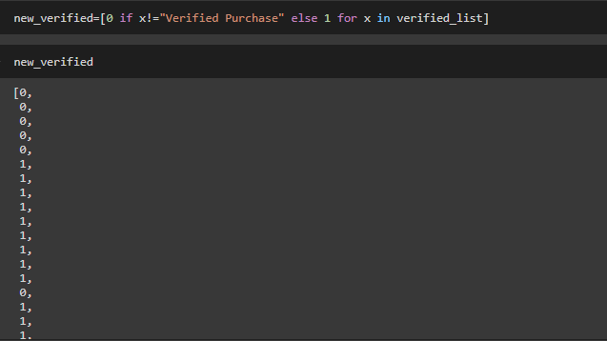

Slide 10
Textblob
TextBlob is a Python (2 and 3) library for processing textual data. It provides a simple API for diving into common natural language processing (NLP) tasks such as part-of-speech tagging, noun phrase extraction, sentiment analysis, classification, translation, and more.

Slide 11
Features
Noun phrase extraction
Part-of-speech tagging
Sentiment analysis
Classification (Naive Bayes, Decision Tree)
Tokenization (splitting text into words and sentences)
n-grams
Word inflection (pluralization and singularization) and lemmatization
Spelling correction

Slide 12
Fake Review Detection
Classification assigns items in a collection to target categories or classes. The goal of classification is to accurately predict the target class for each case in the data. Each data in the review file is assigned a weight and depending upon which it is classified into respective classes.
Here We use one algorithm to get better and accurate result
Naive Bayes

Slide 13
Final Output
The first output is sentiment score of a specified review.
Second output is count of the maximum number of reviews by a purticular product id .

Slide 14
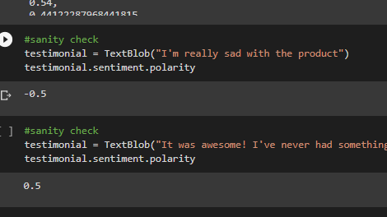
Sentiment Score

Slide 15
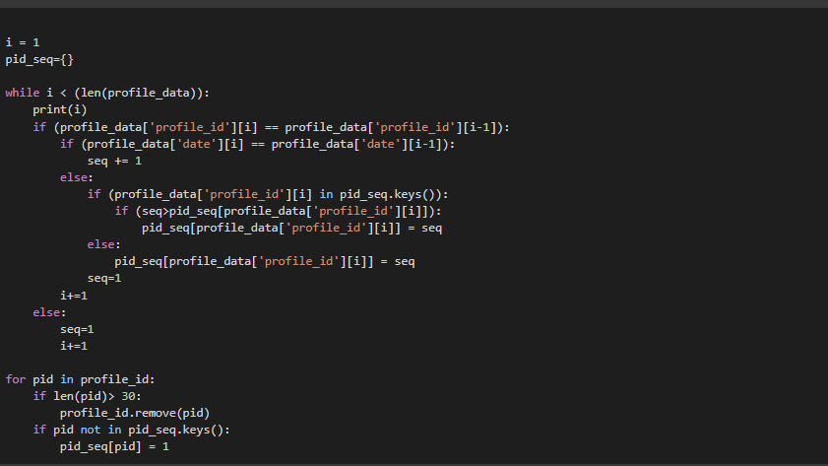

Slide 16
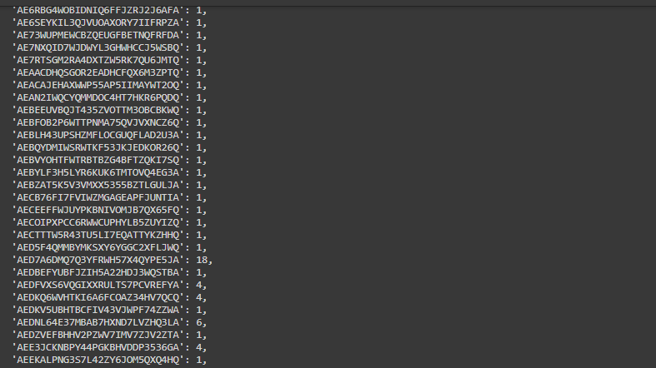

Slide 17
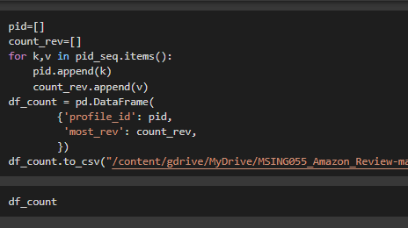

Slide 18
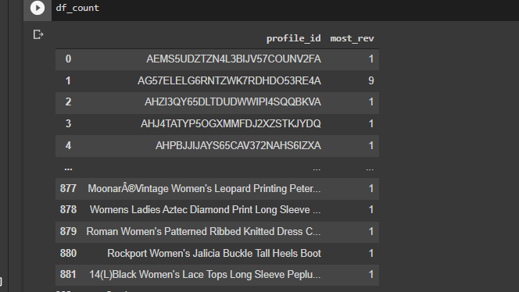

Slide 19
References
1.http://snap.stanford.edu/data/web-Amazon-links.html
2.https://dspace.mit.edu/bitstream/handle/1721.1/119727/1078649610-MIT.pdf
3. https://www.cs.uic.edu/~liub/FBS/sentiment-analysis.html
4.https://www.marketwatch.com/story/10-secrets-to-uncovering-which-online-reviewsare-fake
5.: https://li.st/jesseno/positivenegative-and-neutral-emojis-6EGfnd2QhBsa3t6Gp0FRP

Slide 20
Thank You

